Slide 1
Processing food
Introduction: What is food processing?

Slide 2
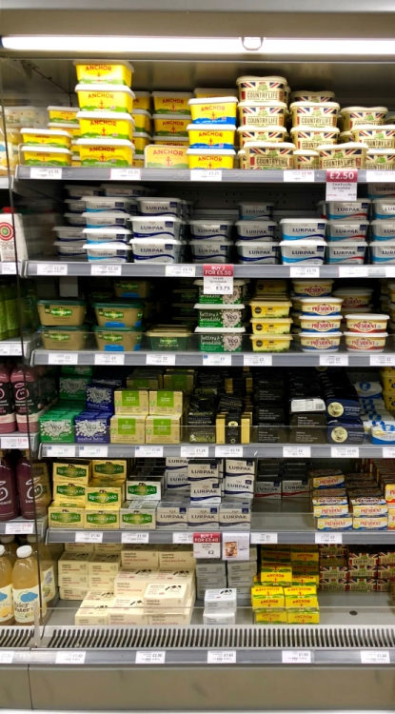
Food processing
Most food in shops and supermarkets is processed
Processing food makes it last longer, taste differently or look differently

